Slide 1

PANORAMA
HOTEL
Network infrastructure
CCNA project presentation
Notes:
Panorama Hotel models two buildings in different parts of the same city. This illustration is conceptual, not a screenshot of the Packet Tracer file. We will explain why the departments are separated and how shared services remain reachable.

Slide 2
Two buildings, one service network
02
Building A
Departments
Shared
services
Building B
Departments
Staff, devices and wireless users can use the same central services.
Notes:
The scenario has two hotel buildings. Departments need their own local networks but common DHCP, DNS and hotel web services. The central service network avoids one independent server set per department.

Slide 3
Network architecture
03
Users + APs
2960 access
3650 routing
Services + edge
A simplified view of the saved design
Notes:
Four Cisco 2960 switches connect clients and APs. SW-L3-1 and SW-L3-2 provide VLAN SVIs and gateway redundancy. SW-L3-3 and SW-L3-4 connect routed paths toward the service and edge segment; RTR-1 connects to simulated RTR-2. This diagram simplifies the physical topology, so it must not be presented as a Packet Tracer screenshot.

Slide 4
VLANs separate departments
04
VLAN 10
Reception
VLAN 50
IT
VLAN 20
Accounts
VLAN 60
Management
VLAN 30
HR
VLAN 70
Printers
VLAN 40
Sales & Marketing
Notes:
In the documented configuration, VLAN 10 is Reception, 20 Accounts, 30 HR, 40 Sales and Marketing, 50 IT, 60 Management and 70 Printers. VLANs separate Layer-2 broadcast domains. Inter-VLAN routing on the multilayer switches still allows network communication; no departmental ACL restriction is claimed. VLAN 1 serves wireless clients; VLAN 5 is an infrastructure/reserved SVI.

Slide 5
Inter-VLAN routing and HSRP
05
Virtual gateway
.254
Client VLANs
Shared services
SW-L3-1
SW-L3-2
Preferred
Standby peer
Notes:
Multilayer SVIs route between user VLANs. Clients use the HSRP virtual address ending in .254 rather than a particular switch interface. SW-L3-1 has priority 150 and preempt on departmental VLANs, so it is the preferred active gateway in the saved configuration; the live state and failover still need demonstration.

Slide 6
OSPF learns internal routes
06
SW-L3-3
User gateways
Services
OSPF area 0
SW-L3-4
Notes:
OSPF process 1 area 0 exchanges the internal routes among the Layer-3 devices and RTR-1. The routed design has paths through SW-L3-3 and SW-L3-4. Dynamic routing is used so the devices learn remote networks. This slide illustrates possible paths; actual convergence is an item for live verification.

Slide 7
EtherChannel | physical links
07
F0/8
SW-L2-0
SW-L2-1
F0/11
Two separate physical cables
Notes:
On SW-L2-0 and SW-L2-1, FastEthernet0/8 and FastEthernet0/11 are the physical member links. The other pair SW-L2-2 and SW-L2-3 uses the same member numbers. Both sides use channel-group 1 mode active.

Slide 8
EtherChannel | one logical trunk
08
Port-channel1
SW-L2-0
SW-L2-1
LACP active • trunk
Two physical links act as one logical trunk
Notes:
EtherChannel bundles the two physical links into Port-channel1, which carries VLAN traffic as a trunk. LACP active negotiates the bundle on both switches. It increases aggregate link capacity and can keep the bundle available if one member link fails, but the actual status should be checked with show etherchannel summary.

Slide 9
Centralized network services
09
DHCP
DNS
HTTP
192.168.120.2
192.168.120.3
192.168.120.4
Client requests reach DHCP through SVI relay
Notes:
The DHCP server assigns the addresses, masks, .254 gateway and DNS address to user VLANs. ip helper-address on the SVIs forwards DHCP broadcasts to the server at 192.168.120.2. DNS resolves www.panoramahotel.com to HTTP server 192.168.120.4. The servers are documented with gateway .5, so the server-side HSRP .254 VIP is not their active default gateway.

Slide 10
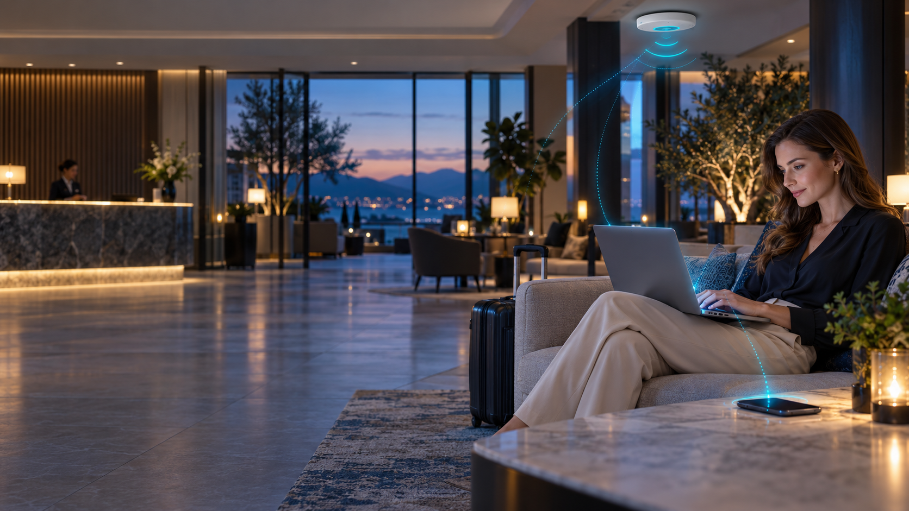
Wireless
clients
4 access points
Laptops + phones
SSID: Default • VLAN 1
Notes:
Illustrative image only, not a photograph of Panorama Hotel. The saved project contains four access points and wireless-capable laptops and smartphones. The documented SSID is Default, and clients use VLAN 1 / 192.168.1.0/24 with .254 gateway. The source indicates open/no-key authentication, so do not claim WPA protection.

Slide 11
PAT at the simulated edge
11
Private client 1
RTR-1
PAT overload
RTR-2
Simulated outside
Private client 2
Private client 3
Many private sources share 209.165.200.233
Notes:
RTR-1 translates inside private sources to its outside interface address 209.165.200.233 using ip nat inside source list 1 interface GigabitEthernet0/0/1 overload. The overload keyword means PAT: many inside flows can use one outside IPv4 address by distinguishing ports. RTR-2 simulates the external side; this is not a real Internet connection.

Slide 12
SSH and basic device setup
12
SSH
Router / switch
Hostnames • enable secret • MOTD
Notes:
SSH is used for encrypted remote CLI management instead of plaintext Telnet. The project also includes basic configuration: device hostnames, enable secret, line passwords, password obfuscation, and MOTD warning banner. Avoid claiming departmental ACLs, a firewall, port security, or complete network security.

Slide 13
What we verify live
13
VLANs + trunks
HSRP
show vlan brief
show standby brief
EtherChannel
PAT
show etherchannel summary
show ip nat translations
Notes:
These are verification steps, not reported successful outcomes. In the live Packet Tracer session also check OSPF neighbors and routes, a DHCP lease, DNS resolution, access to the hotel web page, and controlled failover. Record observed results rather than marking tests as passed from configuration alone.

